Slide 1


AI-Powered Plant Recommender For Air Purification
TEAM MEMEBERS
B. Charan Kumar (22891A1205)
P. Hemanth Kumar (22891A1241)
H.NITHIN (22891A1221)
P.CHANDU (22891A1238)

Slide 2

Abstract:
Combining machine learning-based air quality prediction with plant-based purification, the system forecasts AQI using models like Decision Tree, Random Forest, and Linear Regression based on pollutants such as PM2.5, PM10, CO, and NO₂. It recommends effective plants (e.g., Snake Plant, Bamboo Palm) for pollutant absorption. This approach enables real-time monitoring and natural mitigation, fostering healthier, eco-friendly smart environments.

Slide 3
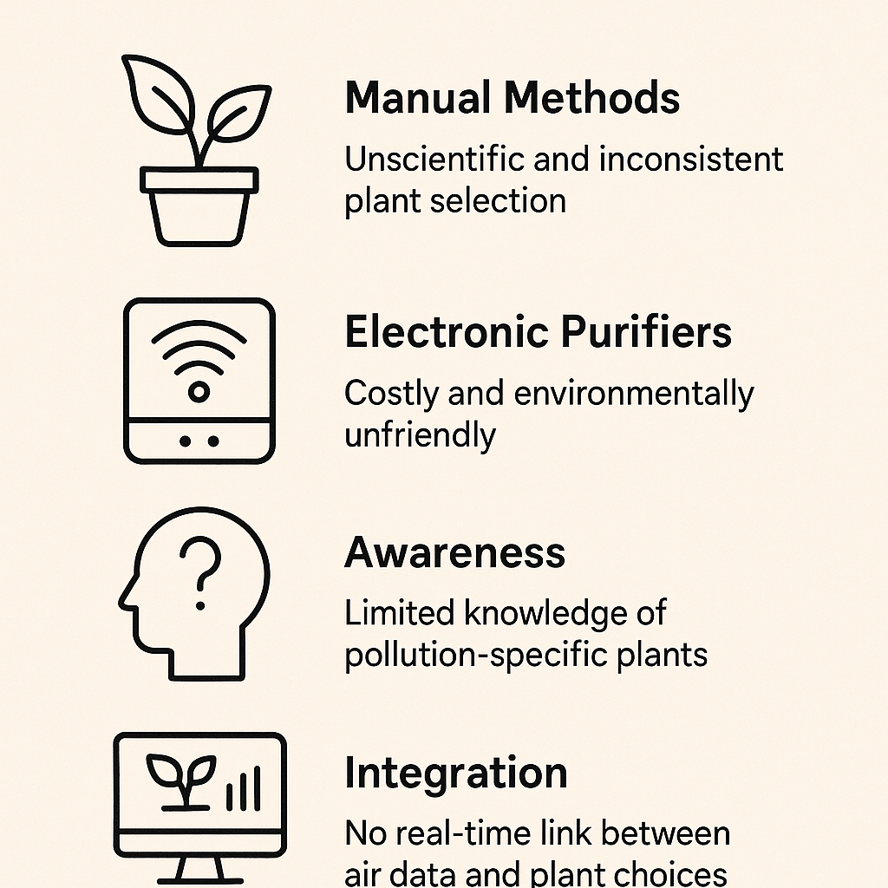
Problem Statement
Indoor air can be 2–5 times more polluted than outdoor air, contributing to ~3.8 million deaths every year (WHO)."
Key Issues:
People don’t know which plants effectively absorb which pollutants like CO, NO₂, or PM2.5.
Commercial air purifiers are expensive, require electricity, and generate e-waste.
There’s no intelligent system connecting pollution levels with plant-based air purification.

Slide 4
Proposed Solution
"Bio Breathe is a machine learning-powered web application that recommends specific air-purifying plants based on pollution levels entered by the user."
Key Highlights:
Uses a Random Forest ML model trained on CO, NO₂, SO₂, PM2.5, and PM10 levels.
Integrated with Django to provide a user-friendly web interface.
Outputs scientifically backed, personalized plant recommendations for indoor air purification.
Simplified Architecture Flow:
Pollution Input → ML Model → Plant Recommendation

Slide 5
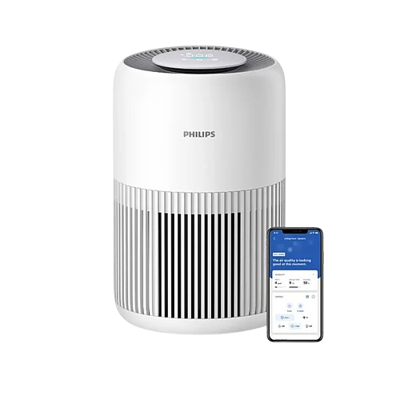
Limitations
Manual plant selection is unscientific and inconsistent.
Electronic purifiers are costly and not environmentally friendly.
No intelligent system to match pollution levels with plant absorption capacity.
Limited awareness about pollution-specific plants
Why This Project is Better:
No Electricity: Plants work 24/7 without power.
No Ozone: Safe, no harmful emissions.
Cost-Effective: One-time plant investment, no filter replacements.
Eco-Friendly: No e-waste, plastic, or chemicals.
Boosts Oxygen & Humidity: Improves air quality and prevents dry air.
Low Maintenance: Just water the plants, no filters to clean.

Slide 6

THANK YOU

